Slide 1
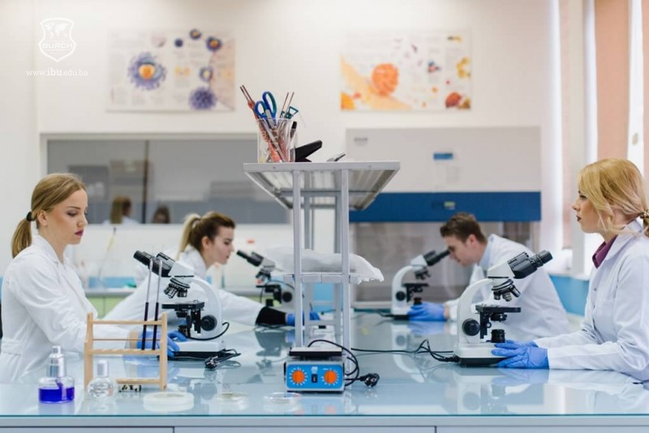
Etiopathogenetic aspects of inflammatory diseases of the oral mucosa

Slide 2
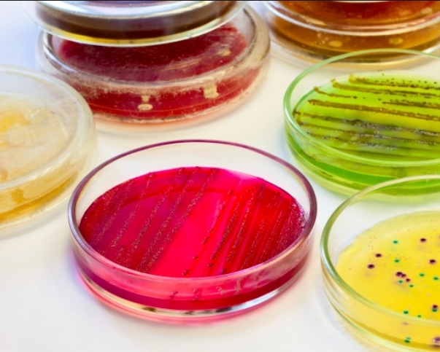
Мотиваційна характеристика.
In the oral cavity there are specific changes in the mucous membrane in bacterial diseases. Such patients often go to the dentist at the beginning of the disease. Therefore, the dentist must know the clinical manifestations of these diseases in the oral cavity, diagnose them and participate in prevention and treatment in order to timely detect and prevent their spread.

Slide 3
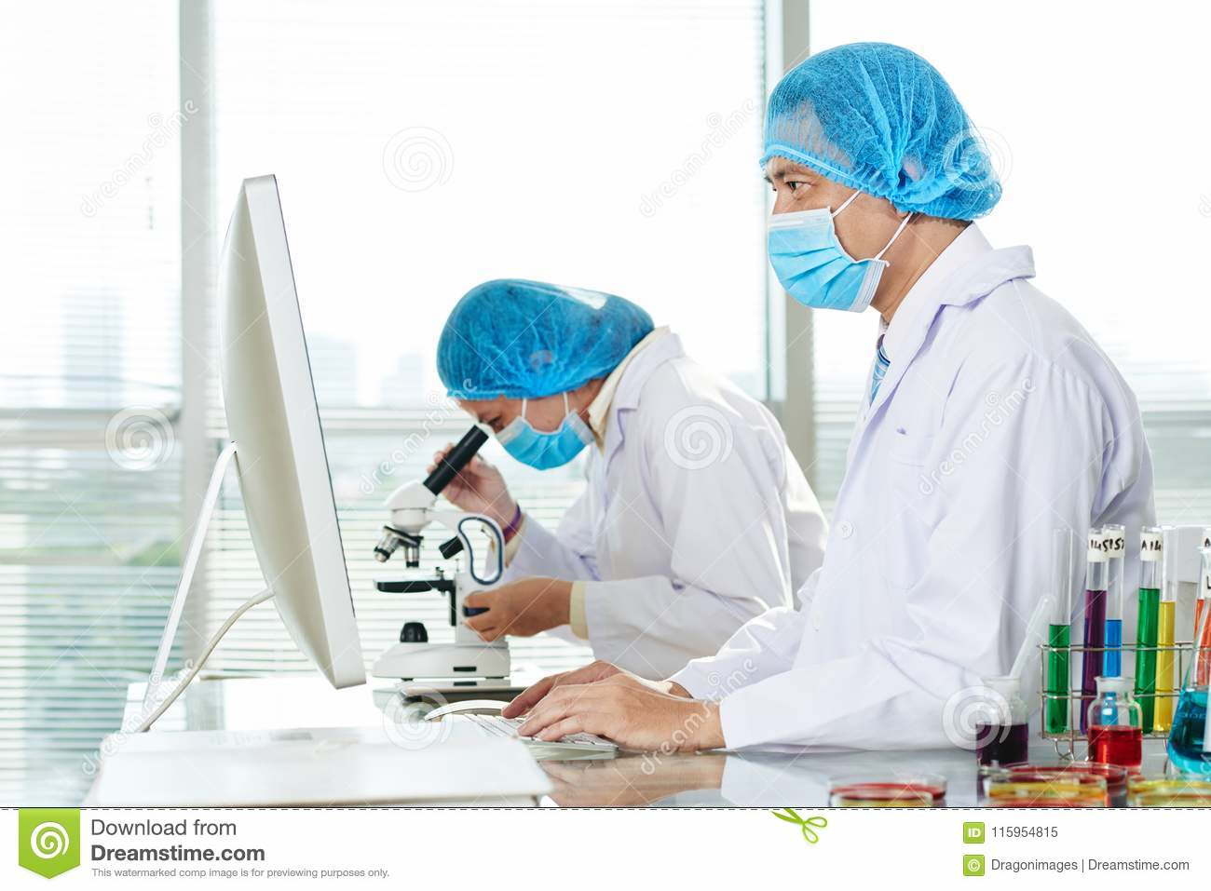
Мета та завдання навчальної дисципліни
The purpose of teaching the discipline is to study the etiopathogenetic role of opportunistic bacteria, fungi, protozoa and some viruses in the development of inflammatory diseases of the oral membrane.

Slide 4
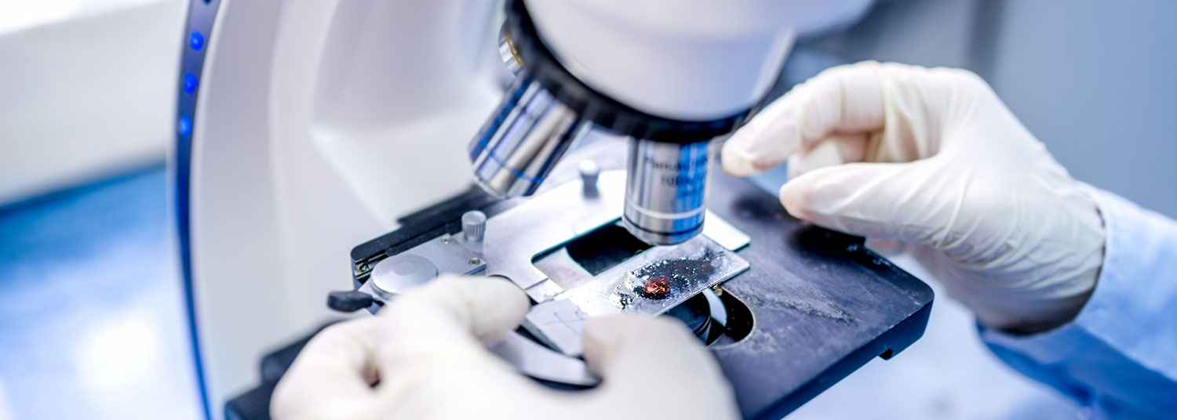
Learn to diagnose the manifestations of bacterial, fungal and viral diseases in the oral cavity, to differentiate them from similar diseases, to clarify the role of the dentist in prevention and treatment.

Slide 5
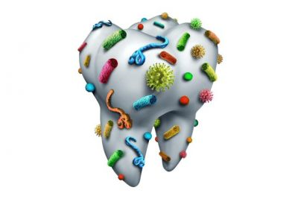
The main tasks of studying the discipline
Study of microbial characteristics of pathogens of major diseases of the oral mucosa;
To study methods of microbiological diagnosis of infectious pathology of the oral mucosa;
To study autoimmune processes and autoimmune diseases of the oral cavity associated with the violation of histohematological barriers;
Be able to interpret the results of microbiological diagnosis of inflammatory diseases of the oral mucosa.

Slide 6
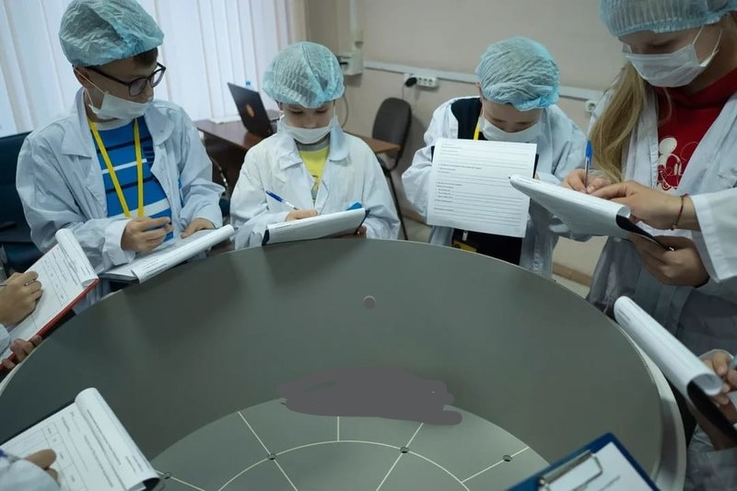
As a result of studying the discipline you will know:
Basic materials for microbiological research in inflammatory diseases of the oral mucosa.
Features of microbiological diagnosis of inflammatory diseases of the oral mucosa of bacterial, fungal, protozoal and viral etiology.
The main etiological agents in the development of inflammatory diseases of the oral cavity.
Classification of antiviral chemotherapeutic drugs used in the treatment of viral lesions of the oral mucosa.

Slide 7
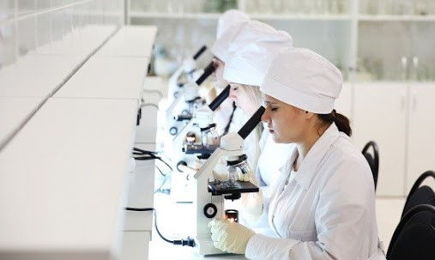
As a result of studying the discipline you will be able to:
Interpret the results of determining the sensitivity of microorganisms to antimicrobial drugs
Take into account and interpret the results of immunochemical diagnostic reactions: RIF, ELISA and molecular genetic methods for the diagnosis of infectious diseases.
Differentiate inflammatory processes of the oral mucosa depending on the etiopathogenetic factor of the disease
Interpret the principles of etiotropic therapy and specific prevention of diseases of the oral mucosa.

Slide 8
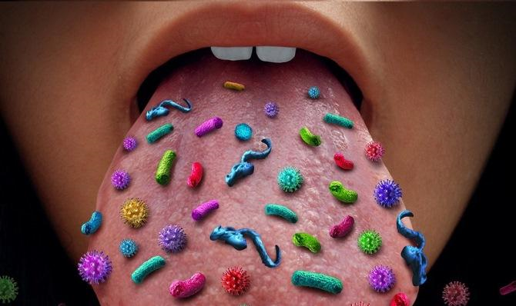
READY TO HELP TO UNDERSTAND AND WISH YOU SUCCESS

